Slide 1
THE 2021 NEW DEEP WINGS MEETING JULY 31ST, 2021

Slide 2
OPENING STATEMENT & INTRODUCTIONS
THANK YOU FOR COMING TODAY.
THANK YOU FOR JOINING OUR COMMUNITY.
WHY WE NEED YOUR HELP.
PHIL LONG…………..assignphillong@yahoo.com …..(810) 444-0670
DAVID LEYTON…….david.s.leyton@gmail.com …….(810) 516-0700
TOM RAU…………….sporttom48@yahoo.com….……(810) 444-2810
JOEL BARNES……….jb3commish@gmail.com………..(810) 919-6326

Slide 3
OFFICIATING PHILOSOPHY
CONFIDENCE – This comes with rules and mechanics knowledge & experience (snaps).
COMMUNICATION – RESPECT to all; coaches, players & crew mates.
UNIFORMS – Hats, Shirts, Pants & Shoes.
EQUIPMENT – Flag, Whistle, Bean Bag, Game Card & Down Counter.

Slide 4
OFFICIATING PHILOSOPHY
NO-NO’s – Hands on hips, Signaling while running, Confrontational Responses, & Over Use of the Whistle.
We have no “Down Time” – Officiate the entire game including timeouts.
KEEP Your Hands OFF of the players.
WHEN “TO” AND WHEN “NOT TO” THROW THE FLAG:
(TRAIN WRECKS VS FENDER BENDERS)

Slide 5
OFFICIATING PHILOSOPHY
Deep Sides – Let a potential incomplete pass hit the ground before sounding your whistle.
Crew Savers – If you have information about something, don’t keep it to yourself, “Share” with your crew.
Basic Fundamental Terms you need to understand.
Live Ball
Dead Ball
Forward Progress

Slide 6
POSITIONING – (GENERAL)
When showing up for your first game, what would be one of the MOST important things for a new official to know ?
Answer – where am I supposed to be lined up.
What are the 7 positions for the officials ? R, U, H, L, B and FJ/SJ.
The next few slides will get you in the right spots, depending on the type of play that is about to happen.

Slide 7
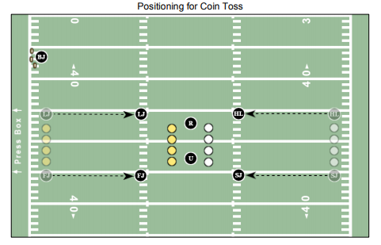
POSITIONING – COIN TOSS

Slide 8
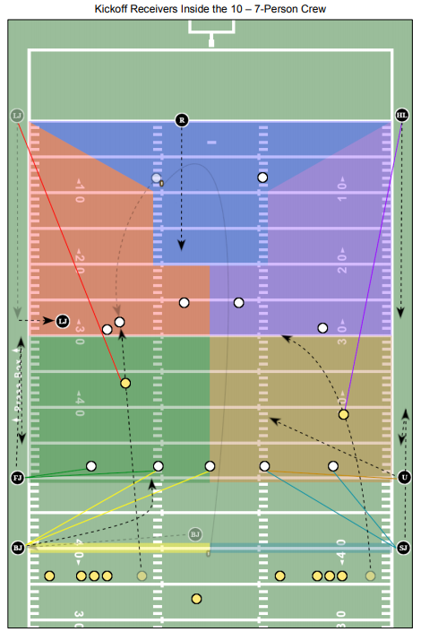
POSITIONING – FREE KICKS (KICKOFFS)

Slide 9
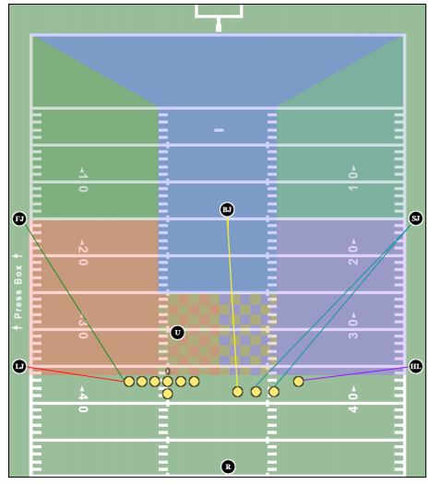
POSITIONING – SCRIMMAGE DOWNS

Slide 10
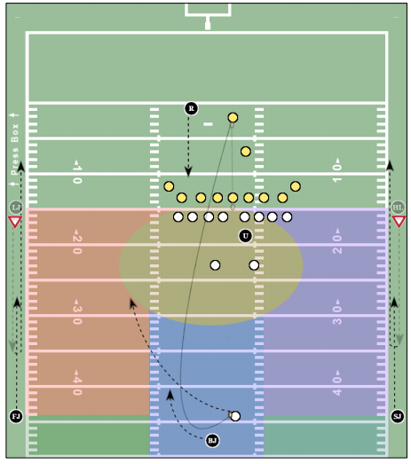
POSITIONING – SCRIMMAGE KICKS (PUNTS)

Slide 11
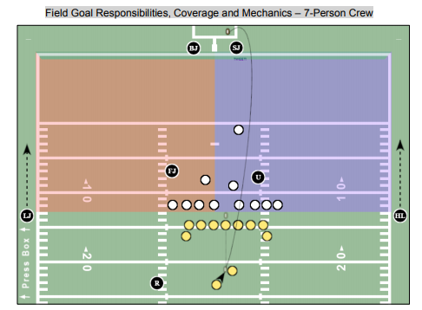
POSITIONING – FIELD GOALS & TRYS

Slide 12
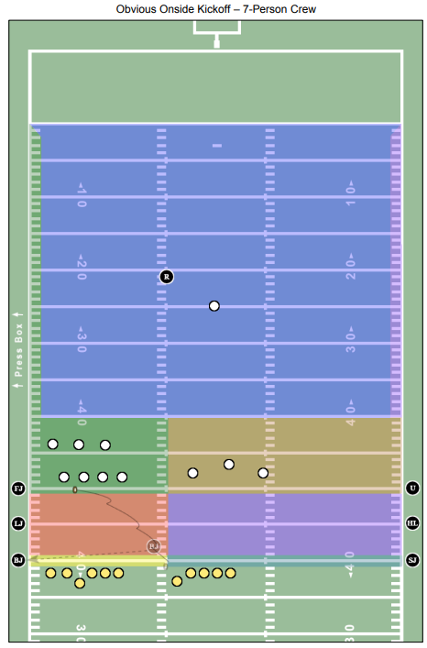
POSITIONING – FREE KICKS (ONSIDE)

Slide 13
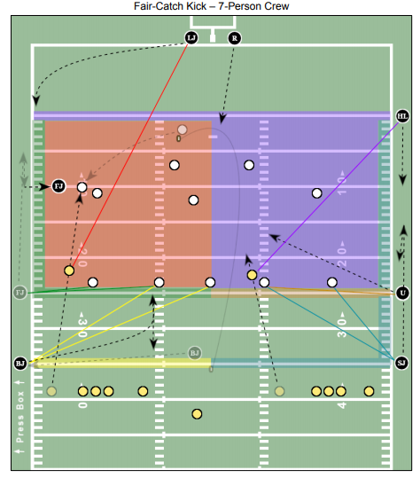
POSITIONING – FREE KICK (AFTER FAIR CATCH)

Slide 14
DEAD BALL OFFICIATING – PRE SNAP
GET PLAYERS OUT OF JEOPARDY.
COUNT PLAYERS & CONFIRM WITH BJ (TEAM B).
KNOW THE NUMBER OF THE CURRENT DOWN .
KNOW THE CLOCK STATUS – SHOULD IT BE RUNNING OR STOPPED.
IDENTIFY WHO YOUR INITIAL KEY IS.

Slide 15
DEAD BALL OFICIATING – AFTER THE PLAY
ACCORDION IN FROM THE SIDELINE – BE A PRESENCE.
HELP WITH THE BALL & CLEARING THE PLAYERS.
INDICATE THE NUMBER OF THE NEXT DOWN – BY RAISING BOTH HANDS OVER HEAD WITH FINGERS EXTENDED, BACKING UP TO YOUR POSITION & DROPPING THEM ON THE SIGNAL FROM THE R.
COVER YOUR PARTNERS FLAG WHEN THERE IS A PENALTY.

Slide 16
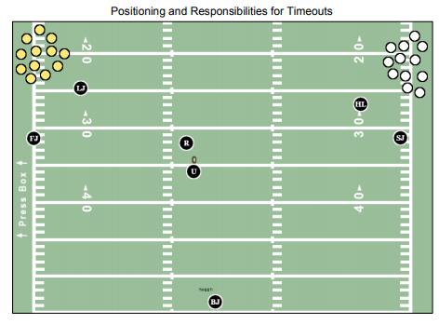
DEAD BALL OFFICIATING – TIMEOUTS

Slide 17
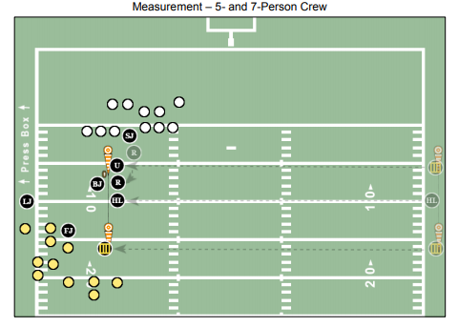
DEAD BALL OFFICIATING - MEASUREMENT

Slide 18
DEAD BALL OFFICIATING – QUARTER CHANGE
1ST TO 2ND & 3RD TO 4TH
HALFTIME

Slide 19
LIVE BALL OFFICIATING
MAINTAIN THAT 20 YD CUSHION.
YOUR FIRST STEP SHOULD ALWAYS BE BACK AWAY FROM THE LINE OF SCRIMMAGE.
THE GOAL LINE IS YOUR RESPONSIBILITY.
YOU HAVE NO FORWARD PROGRESS UNTIL WE GET TO THE 2 YARD LINE – BUT YOU CAN ALWAYS “VERBALLY” HELP YOUR LINE OF SCRIMMAGE PARTNER ON LONG PLAYS.

Slide 20
LIVE BALL OFFICIATING – GOAL LINE
ONCE WE GET TO THE 20 YARD LINE:
THE FJ AND SJ WILL NOW BE FIXED ON THE GOAL LINE.
GIVE YOURSELF SOME ROOM – GET AWAY FROM THE PYLON BY TAKING 2 OR 3 STEPS BACK, YOU DO NOT WANT TO BECOME PART OF THE PLAY.
YOU STILL HAVE FORWARD PROGRESS INSIDE THE 2 YARD LINE.

Slide 21
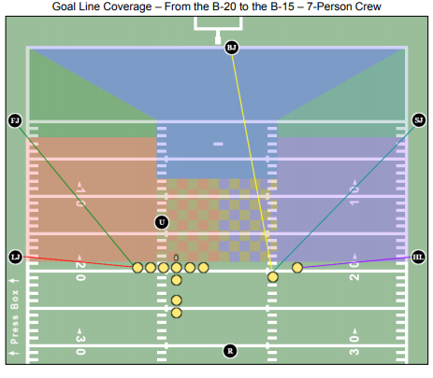
LIVE BALL OFFICIATING – 20 TO THE 5

Slide 22
LIVE BALL OFFICIATING – GOAL LINE
ONCE WE GET TO THE 5 YARD LINE:
THE FJ & SJ WILL NOW BE FIXED ON THE END LINE.
AGAIN, GIVE YOURSELF SOME ROOM BACK THERE.
YOU MAY HAVE TO RULE ON SIDELINE OR THE END LINE.

Slide 23
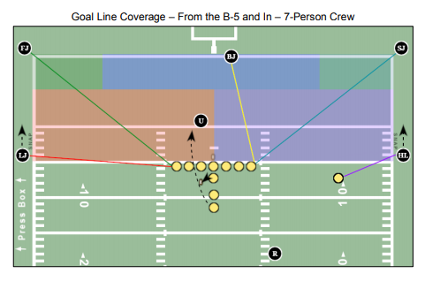
LIVE BALL OFFICIATING – 5 AND IN

Slide 24
LIVE BALL OFFICIATING – GOAL LINE
BEFORE SOUNDING YOUR WHISTLE AND SIGNALING A TOUCHDOWN, MAKE SURE THE RUNNER IS ACROSS THE GOAL LINE WITH POSSESSION OF THE BALL.
ON LONG SCORING PLAYS:
BEFORE SOUNDING YOUR WHISTLE AND SIGNALING A TOUCHDOWN.
TAKE A LOOK TO YOUR LINE OF SCRIMMAGE PARTNER & MAKE SURE THAT HE DOES NOT HAVE THE PLAY OUT OF BOUNDS.

Slide 25
REVERSE MECHANICS
THIS IS WHEN WE HAVE A CHANGE OF POSSESSION DURING THE DOWN. (INTERCEPTION, FUMBLE OR PUNT RETURN)
NOW EVERYTHING FLIPS, THE FJ AND SJ ARE NOW RESPONSIBLE FOR THE FORWARD PROGRESS AND THE LINE OF SCRIMMAGE OFFICIALS HAVE THE GOAL LINE RESPONSIBILITY.

Slide 26
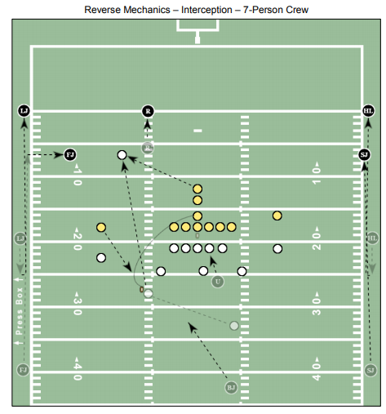
REVERSE MECHANICS

Slide 27
BIG CALLS
CATCH VS NO-CATCH :
HOW DO I KNOW WHICH OFFICIAL IS RESPONSIBLE FOR THE CATCH AND WHO IS RESPONSIBLE FOR THE FEET ?
PASS INTERFERENCE :
REMEMBER THERE MUST BE CONTACT WHILE THE BALL IS IN THE AIR FOR THERE TO BE PASS INTERFERENCE.
BOTH PLAYERS HAVE AN EQUAL RIGHT TO TRY AND CATCH THE BALL.
ONLY MAKE THIS CALL WHEN YOU CAN PUT THE FOUL INTO ONE THE 4 CATEGORIES.

Slide 28
PASS INTERFERENCE
THE 4 CATEGORIES OF PASS INTERFERENCE ARE;
PLAY THROUGH THE OPPONENT.
EARLY CONTACT WITH THE OPPONENT.
GRASP & RESTRICT THE OPPONENT.
HOOK & RESTRICT THE OPPONENT.

Slide 29
CLOSING REMARKS
WE WANT YOU TO BE SUCCESSFUL.
YOU HAVE HELP FROM THE BACK JUDGE IN THE MIDDLE OF THE FIELD AND YOUR LINE OF SCRIMMAGE PARTNER ON YOUR SIDELINE.
REMEMBER THIS IS SUPPOSED TO BE FUN!
THE MECHANICS MANUAL CAN BE FOUND:
ON MHSAA.COM > OFFICIALS > SPORT SPECIFIC CONTENT > FOOTBALL

Slide 30
ANY FURTHER QUESTIONS ???

